Slide 1

Nebraska Outpatient Antibiotic Prescription Data, 2024

Slide 2
How to Use the Information
Data can be included as background in presentation for general antimicrobial stewardship education for:
  Outpatient clinic providers
  Outpatient clinic staff

Slide 3
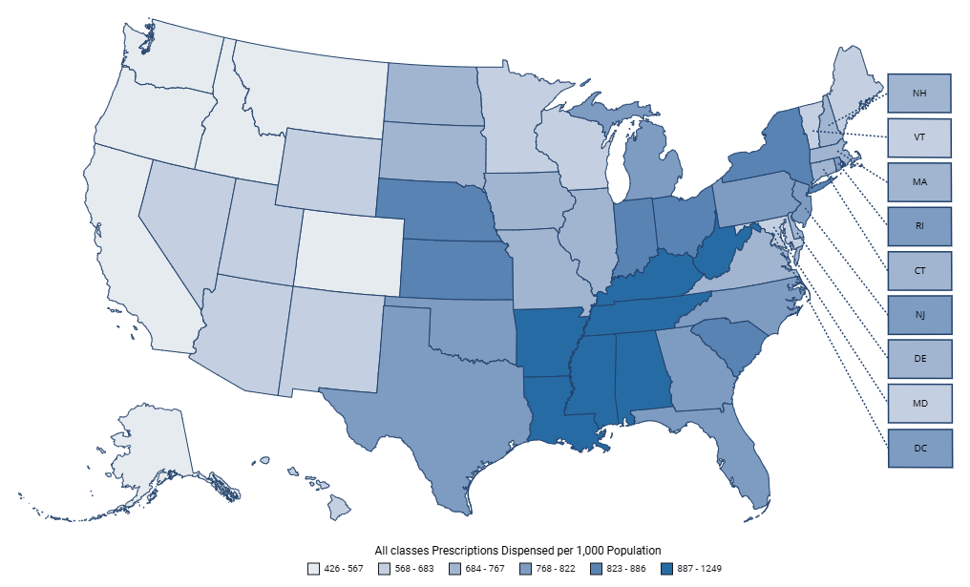
Outpatient Antibiotic Prescribing in Nebraska
All Antibiotic Classes
In 2024, Nebraska was the 10th highest antibiotic prescribing state
(840 prescriptions per 1,000 population)
All Antibiotic Classes | A.R. & Patient Safety Portal (cdc.gov)

Slide 4
Antibiotic Prescribing Trends Over Time
All Antibiotic Classes
All Antibiotic Classes | A.R. & Patient Safety Portal (cdc.gov)

Slide 5
Antibiotic Prescriptions per 1,000 Medicare Part D Beneficiaries, 2024
2024 Publicly Available Medicare Part D Prescribing Data cms.gov

Slide 6
Local Health Department | Total Antibiotics Claimed | % of Total Antibiotics | Total Prescribers | Abx Rx/1,000 Part D beneficiaries
Northeast Nebraska Public Health Department | 4,636 | 1.1 | 41 | 644
North Central District Health Department | 9,442 | 2.3 | 94 | 621
Dakota County Health Department | 3,593 | 0.9 | 25 | 611
Loup Basin Public Health Department | 6,056 | 1.5 | 51 | 600
South Heartland District Health Department | 11,057 | 2.7 | 105 | 564
Two Rivers Public Health Department | 26,528 | 6.5 | 256 | 525
East Central District Health Department | 10,870 | 2.7 | 100 | 525
West Central District Health Department | 9,842 | 2.4 | 108 | 519
Panhandle Public Health District | 19,979 | 4.9 | 184 | 512
Four Corners Health Department | 9,332 | 2.3 | 70 | 510
Three Rivers Public Health Department | 11,757 | 2.9 | 112 | 502
Public Health Solutions District Health Department | 10,362 | 2.5 | 100 | 499
Elkhorn Logan Valley Public Health Department | 13,016 | 3.2 | 148 | 493
Central District Health Department | 17,893 | 4.4 | 177 | 486
Southwest Nebraska Public Health Department | 7,102 | 1.7 | 79 | 484
Sarpy-Cass Health Department | 13,114 | 3.2 | 185 | 465
Southeast District Health Department | 7,346 | 1.8 | 71 | 447
Lincoln-Lancaster County Health Department | 76,969 | 18.8 | 853 | 444
Douglas County Health Department | 139,341 | 34.1 | 1828 | 388
2024 Publicly Available Medicare Part D Prescribing Data cms.gov

Slide 7
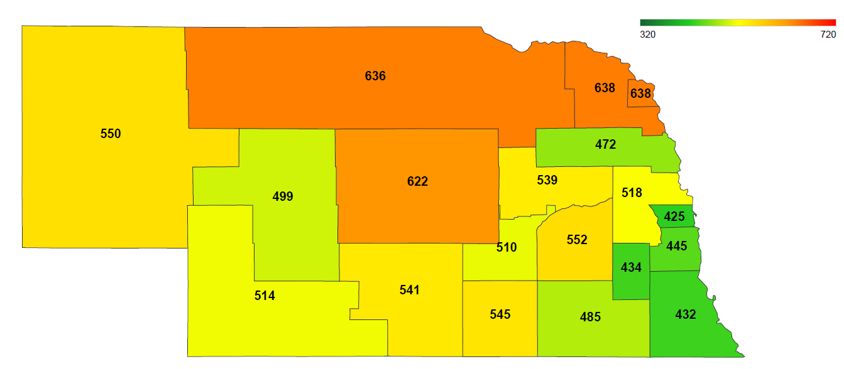
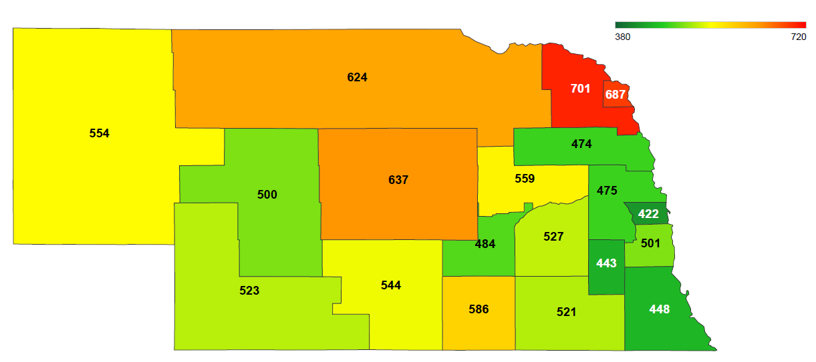
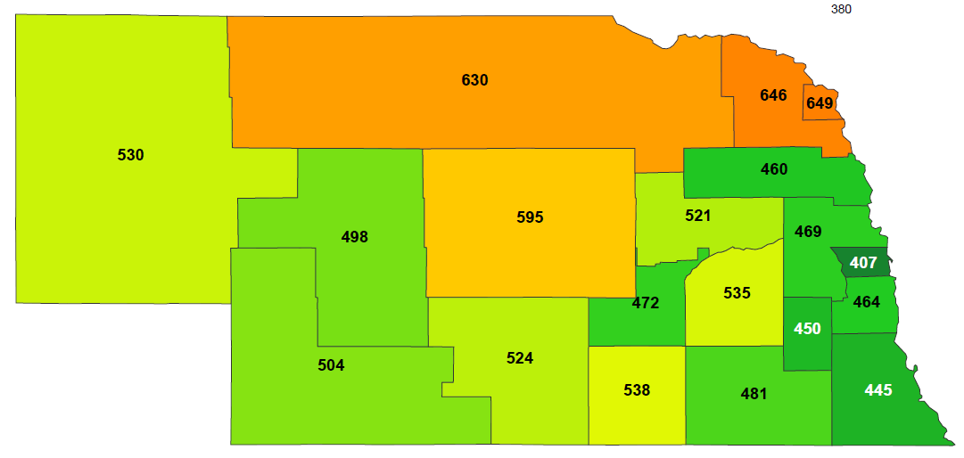
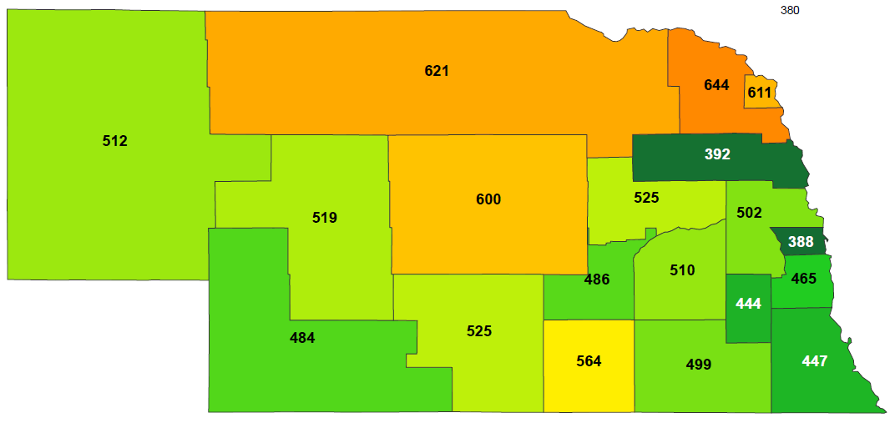

Antibiotic Prescriptions per 1,000 Medicare Part D Beneficiaries
2021
2022
2023
2024
2024 Publicly Available Medicare Part D Prescribing Data cms.gov

Slide 8
Top 10 Antibiotic Prescriber Groups in 2024, Medicare Part D
Provider Type/Specialty | Total Antibiotic Claims (n) | Total Cost of Antibiotic Prescriptions (U.S. $) | Antibiotic Claims Per 1,000 Medicare Beneficiaries | % of Antibiotic Prescriptions | % Cost of All Antibiotic Prescriptions
Family Practice/Medicine | 90,235 | $2,262,574 | 87 | 21.7% | 16.9%
Nurse Practitioner | 79,045 | $2,514,458 | 76 | 19.0% | 18.8%
Physician Assistant | 69,215 | $1,903,555 | 66 | 16.7% | 14.2%
Dentist | 48,790 | $161,133 | 47 | 11.8% | 1.2%
Internal Medicine | 34,250 | $1,671,139 | 33 | 8.2% | 12.5%
Emergency Medicine | 11,722 | $137,583 | 11 | 2.8% | 1.0%
Urology | 9,987 | $169,087 | 10 | 2.4% | 1.3%
Orthopedic Surgery | 8,371 | $38,152 | 8 | 2.0% | 0.3%
Dermatology | 7,008 | $130,416 | 7 | 1.7% | 1.0%
Hospital Medicine | 6,970 | $215,712 | 7 | 1.7% | 1.6%
Total | 365,593 | $9,203,809 | 351 | 88.1% | 68.7%

Slide 9
Trends in Antibiotic Prescriptions per 1,000 Medicare Part D Beneficiaries

Slide 10
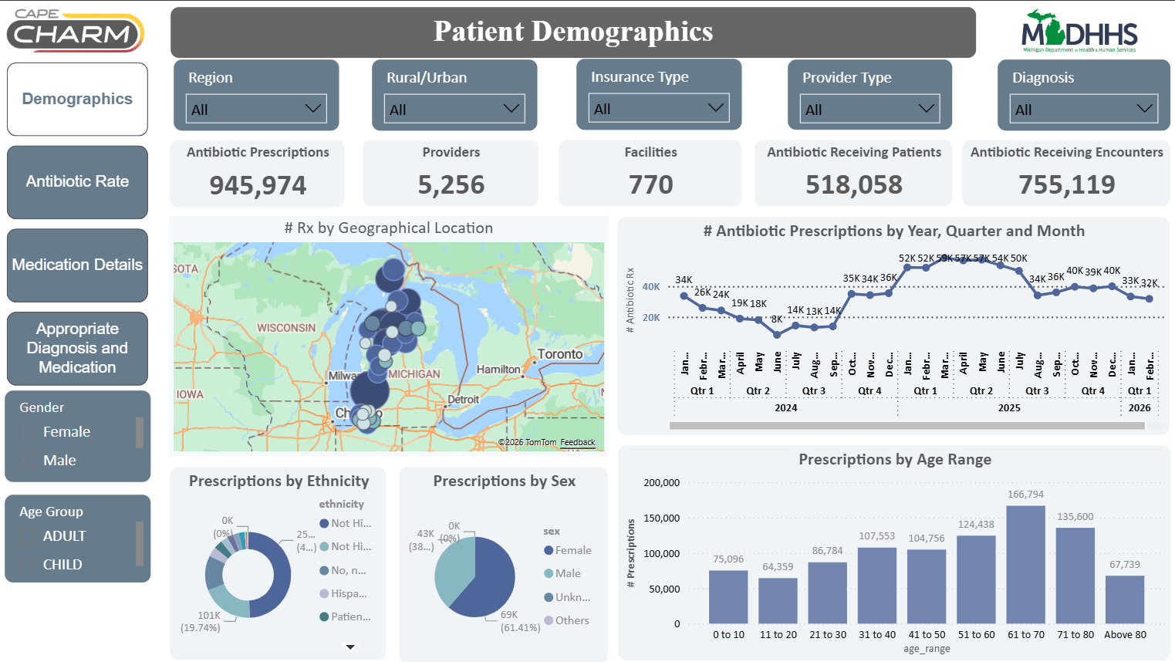
Coming Soon
Nebraska DHHS made Collaboration to Harmonize Antimicrobial Registry Measures (CHARM) free of charge for initial group of outpatient clinics
Made funding available for up to 20 organizations for cost reimbursement related to IT time spent in onboarding CHARM
Clinics will be able to view their own dashboard and compare themselves with a state dashboard
Participating clinics will also be able to request one-on-one consultations related to strategies on improving their antibiotic use
https://www.ferris.edu/cape/charm.htm

